Slide 1
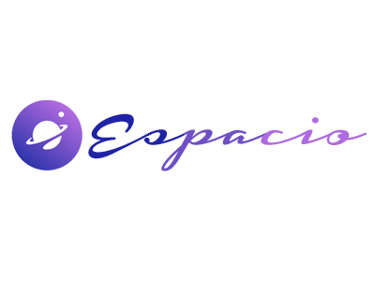
espacio Co.
Brand Overview
The meaning behind the logo mark of espacio Co.
-Our logo is designed keeping in mind various meanings and representations of our ambitions. The details of our logo and correct usage are provided as follows
Our Brand Logo

Slide 2
espacio Co.
Table of Contents
Topics Covered
Logo Guidelines
Positioning
About the Logo
Reminders
Color Palette
About Us
Our Brand Logo
Logo Type
Logo Space
Logo Variation
Table of contents
02

Slide 3

The espacio Logo: Usage Guidelines
espacio Co.
The espacio logo is a trademark of espacio Co..
In order to protect and grow the espacio brand, we have a distinguishable logo that can be used to mark software licensed under an espacio Approved License.
Our Brand Logo
The Standard Logotype
The Symbol
The Logotype
Symbols and Meanings
03

Slide 4
Symbols & Meanings Parts of the
espacio Co. Logo
espacio Co.
Small dot
(Moon)
Our Brand Logo
Circular design
(Planet)
Ring
Represents togetherness and unity in the people inhabiting it , also signifies we protect your planet
Representing sun from our solar system to pay tribute to our first ever home , the earth
Portrays security , continuity and symmetricity
Symbols and Meanings
04
01
02
03

Slide 5


espacio Co.
The espacio Co. Colors
Our color palette for logo usage
This is our official colour code for the logo we always recommend you to use this colour palette only when using our logo
espacio Co.
Blue #2023A5
espacio Co.
Our Brand Logo
Blueish Purple #6E4FC5
espacio Co.
The Beuaray Corp. Colors
Light Purple AE6ADF
05

Slide 6
Logo Font espacio Co.
espacio Co.
Our Brand Logo
Our official logo font
Housegrind Persona...
A B C D E F G H I G K L M N O P Q R S T U V W X Y X
1 2 3 4 5 6 7 8 9 0
This is our official logo font , we always recommend you to use this font while using or representing our logo
06
Logo Font

Slide 7
espacio Co.
Exclusion Zones
The safe
CLEAR SPACE
distance
CLEAR SPACE
CLEAR SPACE
Our Brand Logo
to put your
logo in
CLEAR SPACE
Recommended placement/size :- Length breadth ratio is 3:2 , margin 10% of area from each side .
Exclusion Zones
07

Slide 8
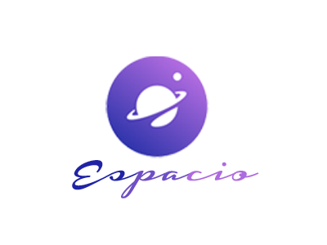
Logo Variations
espacio Co.
Our Brand Logo
Vertical
Horizontal
Icon
Logo Variations
08

Slide 9
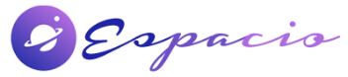
Logo Positioning The safe distance to put your logo in
espacio Co.
The logo can be placed based on where it is best suited depending on application and tone.
Our Brand Logo
Square
Logo Positioning
09
Landscape

Slide 10
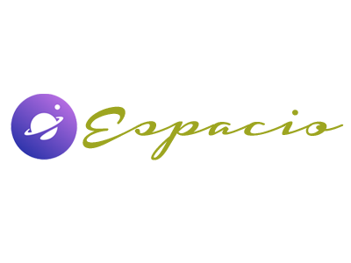


Wrong Logo
Reminders
espacio Co.
Rules on logo use to keep in mind
DO NOT change the color.
Use only the colors in the palette.
DO NOT crop the logo.
DO NOT add shadows or effects.
Our Brand Logo
DO NOT rotate the logo.
DO NOT put over another illustration
DO NOT use tint or opacity.
10
Reminders

Slide 11
About espacio Co.
espacio Co.
We are coders, scholars , graphic designers and a bunch of space nerds . Since 2021, We have an immense experience in the field if pioneering , building prototypes and funding space exploration When:- pleased to share that we expanded our plants over 9 counties across 3 continents during our 50 years of existence . Why:- the eagerness to colonise the universe made us push our limits and create this label How:- through mammoth experimentations and ideation we created a prototype to aid and assist human survival in extraterrestrial atmosphere.
Our Brand Logo
About Beuaray Corp.
11

